Slide 1
CALL GPT
Big Data Analysis – Idea Pitching
권오람 오태건 홍지민

Slide 2
TABLE OF CONTENTS
01
02
Background Ideas
CALL GPT Introduction
03
04
How do we make it FOR REAL?
We are looking for you!

Slide 3
01
Background IDEAS

Slide 4
CHAT GPT & NEW BUSINESS PROJECT
NEW AI era : Generative AI

Slide 5
**수정필요WHO
DEVELOPED IT?
The creator of this language model is the company OpenAI, which specializes in artificial intelligence and is led by Sam Altman, who was in charge of resolving doubts, generating spaces for dialogue and establishing a chat system that allows humans to relate to technology as if it were another person

Slide 6
02
CALL GPT INTRODUCTION

Slide 7
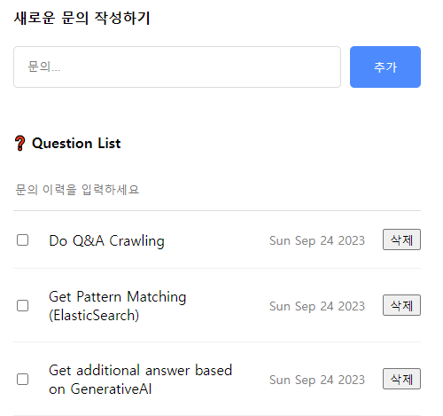
CALL GPT INTRODUCTION
1
배경
2
개요
AICC
(인공지능콜센터) 수요 증대
금융기관 FAQ 수집 & 챗봇 구현
3
구현방법
4
기대효과
Crawling
NLP
금융업권 One-stop서비스 제공을 통한 고객경험 향상

Slide 8
03
HOW DO WE MAKE IT FOR REAL?

Slide 9










HOW DO WE MAKE IT FOR REAL?
React(Frontend) + Spring Cloud(Backend) + AWS Services
EC2 Application Server
DB
Cache
HTTP
Request
MSA Server
Storage
Microservices
Response
AWS Services

Slide 10
HOW DO WE MAKE IT FOR REAL?
1
2
3
4
데이터 수집
시스템 아키텍처 확립
학습 모델 생성
고객 지원 기능 구현
크롤러 작성
데이터 수집
- 금융기관 Q&A
- SQS 사용 데이터 수신
- 검색엔진
Elastic Search 저장
질의응답
문의 Category
간편로그인
문의 이력
Generative AI 모델 구현
구현 모델
서버 업로드
Frontend(React)선택
Backend 구상 및 개선
SpringCloud기반 분산시스템
AWS 활용 또는 타 시스템 아키텍처 전환 검토

Slide 11
04
We are looking for YOU!

Slide 12
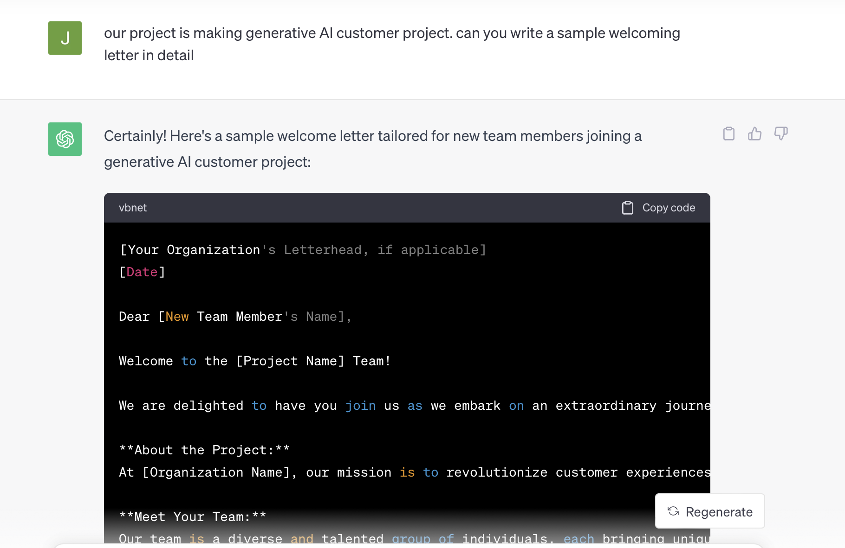
WELCOME LETTER

Slide 13
OUR STATS…
Oram
Jimin
JOIN US!
Taegun

Slide 14
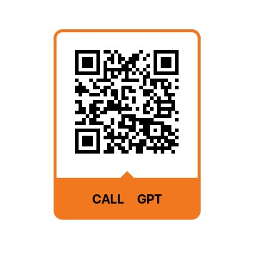
THANK YOU!
DO YOU WANT TO FEEL IT?
http://54.84.19.74/
FEEL FREE TO
START A NEW JOURNEY!

